Slide 1
Fine Tuning a Llama2 Model for Lie Detection
Caltran Lorenzo
Cimbro Letizia
Jahanianarange Nahid
Skurativska Kateryna

Slide 2
The Task

Slide 3
What is Lie Detection?
Lie detection is an assessment of a statement with the goal to reveal whether the person is being truthful or deceptive in their statements.
When people tell lies, they use specific verbal strategies to make others believe their false stories.
Automatized verbal lie detection techniques through the application of Machine Learning and LLMs.

Slide 4
The Model

Slide 5

The Model
Discover whether stories told by people have actually happened or have been imagined (deception)
Llama2
Meta’s open source LLM
Up to 70B parameters

Slide 6
The Dataset

Slide 7
The dataset
The Memory dataset contains 6854 stories about autobiographical experiences collected through crowdsourcing.
Each story has 23 parameters.
The inclusion of variables such as "distracted," "draining," "frequency," and "stressful" suggests an interest in understanding the emotional and cognitive aspects of the storytelling process, which may be relevant for lie detection research.
The variable "memType" likely categorizes the stories into these three types—recalled, retold, and imagined

Slide 8
Categories of Stories:
  Recalled: Stories that are based on actual, personal experiences or events that an individual has lived through or witnessed
  Imagined: Stories that are fictional and created in the storyteller's imagination. They do not have a basis in real events or experiences
  Retold: Stories that involve recounting or narrating events that the storyteller has heard from others

Slide 9
Data Preprocessing

Slide 10
Preprocessing
Before using Memory dataset for fine-tunning the LLama2 model we do the following:
Exclude retold stories from consideration, as they are not fabrications; rather, they involve real occurrences, albeit not directly experienced by the storyteller.
Remove stories for which we don't have story or/and we don't know the type of the story.
After counting exact number of words for each story (using Spacy's English language model) remove stories with number of words below 2.5 of standard deviation.
As a result of preprocessing, we obtained 5507 stories for further usage.

Slide 11
Scenarios

Slide 12
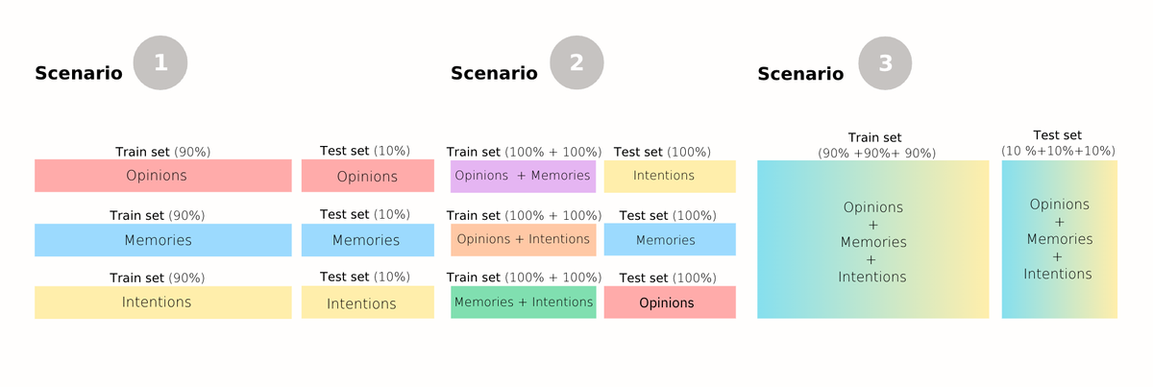
Scenarios

Slide 13

Scenarios
Scenario 1: The model is trained to recognize lies in one part of a dataset and tested if it could spot lies in the remaining part. This should be done for each dataset, using a fresh copy of the model each time. This is done to see how well the model can learn to detect lies in the same situation.
Scenario 2: The model is trained on multiple datasets and then tested it on another one that it has not seen before. This should be repeated multiple times, using different datasets combinations of datasets each time. This helps to understand how well the model can handle new situations it hasn't encountered during training.
Scenario 3: The model is trained and tested on a combination of all the datasets. This allows to figure out if the model can learn and find lies in stories from different situations.

Slide 14
Fine Tuning

Slide 15
Fine tuning
Llama2 has multiple purposes, such as:
◦ Summarizing, expanding, rewriting and changing the tone of voice of an input text;
◦ After entering a text prompt, Llama2 attempts to predict the most plausible follow-on text;
What we are going to do is apply fine-tuning. In machine learning, fine tuning is the process of adjusting the weights and parameters of a pre-trained model on new data to improve its performance on a specific task.

Slide 16
Methodology

Slide 17
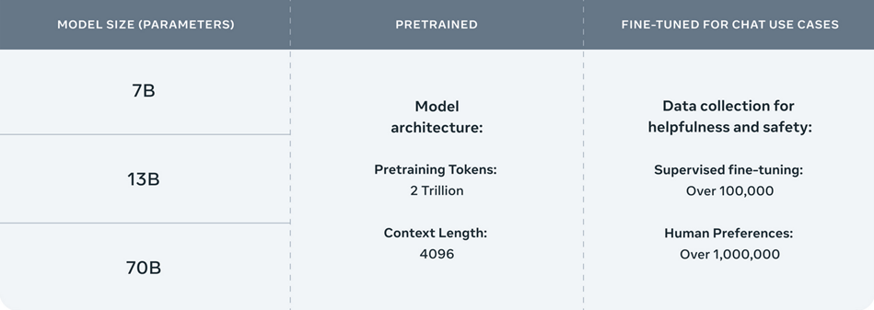
Methodology
  As we can see, there a multiple versions of the Llama 2 models. Due to limitations with the GPU we fine tuned the Llama2 Chat model with 7B parameters.

Slide 18
Generating a prompt
The following step is to transform the texts contained in the train and test data into prompts to be used by Llama. For both the training and test set the prompt contains specific instructions about what our goal is: to categorize each story as either 'imagined' or 'recalled', aside from the that, the train set prompt also contains the story that we want to categorize and the assigned label, while the test prompt only contains the story.

Slide 19
The training phase
The last thing to do is to configure and initialize a Simple Fine-tuning Trainer (SFTTrainer) for training a large language model using the Parameter-Efficient Fine-Tuning (PEFT) method, which should save time as it operates on a reduced number of parameters compared to the model's overall size.
The PEFT method focuses on refining a limited set of additional model parameters, while keeping the majority of the pre-trained LLM parameters fixed.

Slide 20
Results

Slide 21
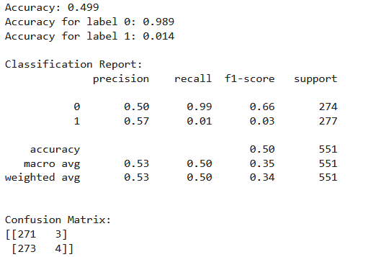
Results before Fine Tuning
As we can see the original model is not able to carry out the task with satisfying results, as it only categorizes the stories as ‘imagined’ or it’s not able to categorize them at all.

Slide 22
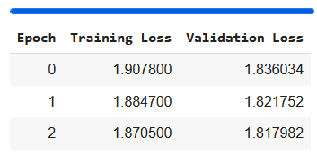

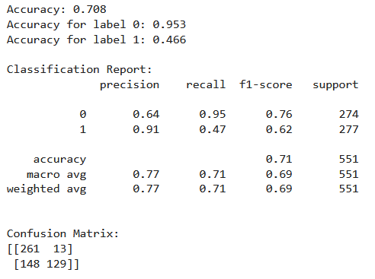
Results after Fine Tuning
After 3 training epochs we can observe a significant increase in the accuracy, even though we observed high values for the training and evaluation loss

Slide 23
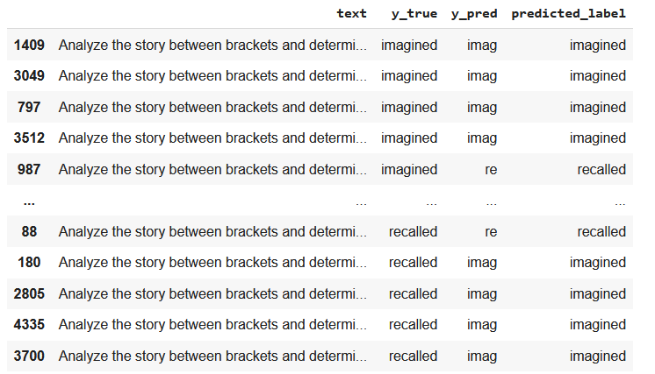
Observations
What we observed is that while the model is able to categorize the stories with good accuracy, it is not able to generate correctly the label text.

Slide 24
Conclusions
In conclusion, the study highlights the potential of advanced language models to uncover and classify cognitive processes embedded in textual narratives.
The findings contribute to our understanding of human cognition and memory, while also offering practical applications in various domains.
By leveraging cutting-edge technologies and interdisciplinary approaches, researchers can continue to advance our knowledge of storytelling, memory recall, and cognitive functioning in both theoretical and practical contexts.

Slide 25
Thanks for the attention

